Slide 1
GLOBEX
Apoorva Kethamaranahalli 001090928
Shreyas Chittlur Ramesh 001568012
Tharoon Kumar Viswanathan 001585510

Slide 2
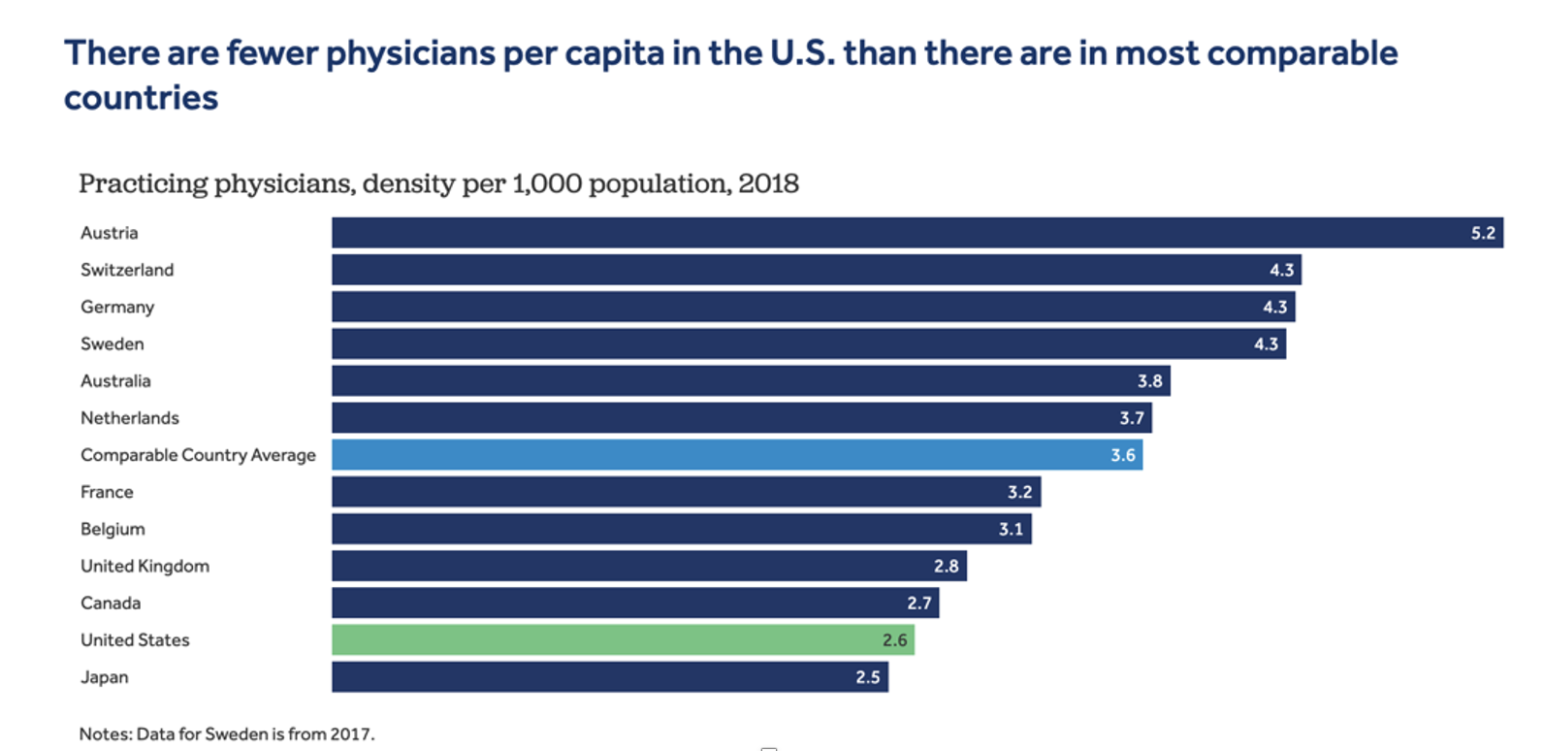
PROBLEM STATEMENT
From the past 17 years, there has been an observable shortage in the doctor to patient ratio in the U.S, particularly noticeable after the onset of the coronavirus pandemic. According to Kaiser Family Foundation Analysis of OECD Data, the ratio of practicing physician’s density per 10000 population has been less than the average mark compared to other countries like Austria, Switzerland, Germany, and many more.
Although it is advisable to visit a doctor whenever you have health concerns, the availability of the doctor plays an important role in determining these regular visits which when reduced leads to a dire consequences.

Slide 3
PROPOSED SOLUTION
01
02
Our solution proposes an ecosystem model to bring healthcare and emergency services under one umbrella to ensure that users have widespread access to healthcare professionals and emergency services in their cities so that we reduce the risk of delayed or ignored diagnostics by making it a 24/7 online support for any queries patients might need answers for.
With Globex, a patient can stay at the convenience of their homes, and complete the entire process of booking doctor appointments, consultations, lab tests, along delivery of medicines. Globex also provides patients with suitable insurance plans they can choose from and also aims to provide a fast and efficient emergency response team for the patients.

Slide 4
SALIENT FEATURES
APPOINTMENT
ORDER
INSURANCE
STATUS
INVENTORY
EMERGENCY
User can schedule Doctor Appointments and Lab tests
User can order medicine from the Pharmacy and get it delivered.
User are provided with a wide range of insurance plans which they can choose from.
Users are updated periodically about the status of their request.
Users can avail emergency services with just a click of a button
Hospitals can order inventory items from suppliers

Slide 5
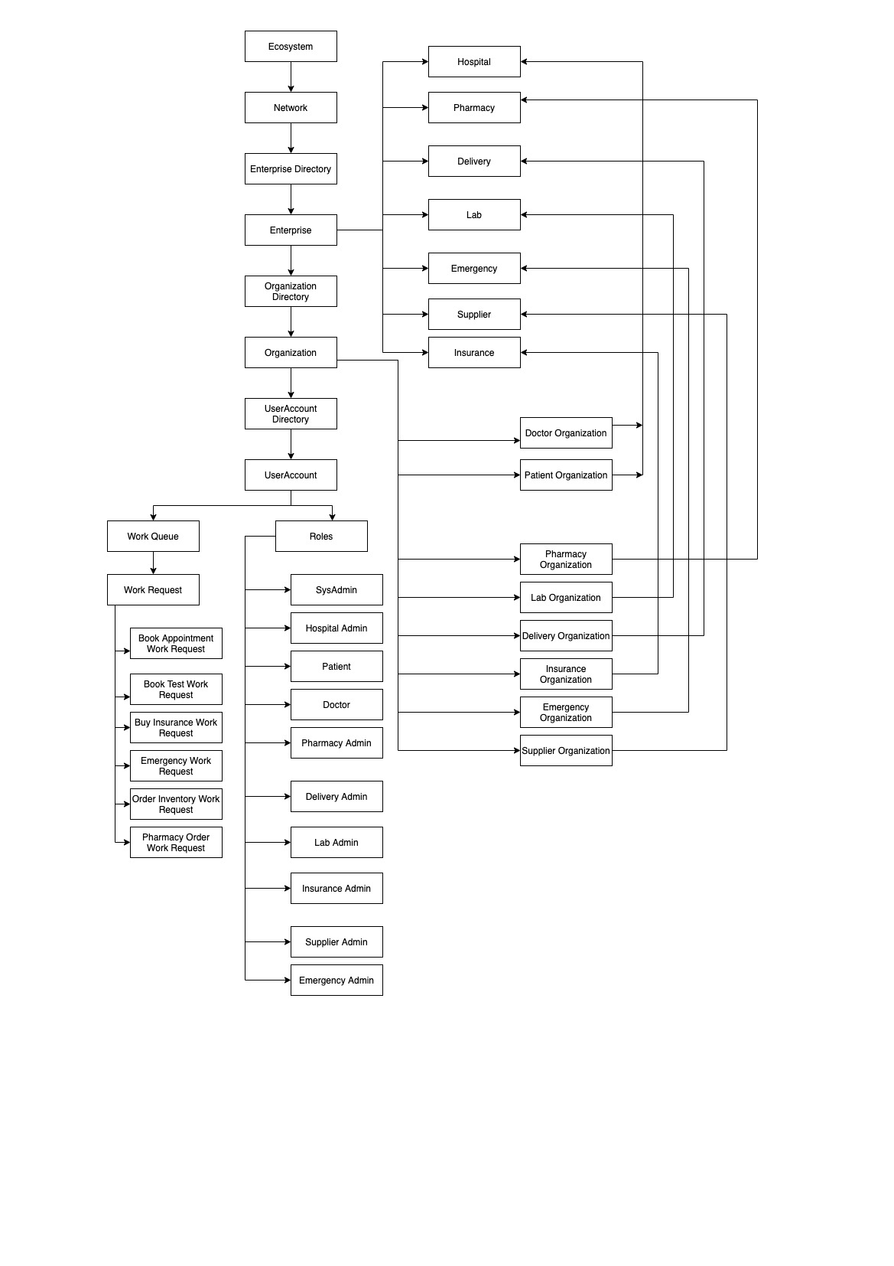
SYSTEM ARCHITECTURE

Slide 6
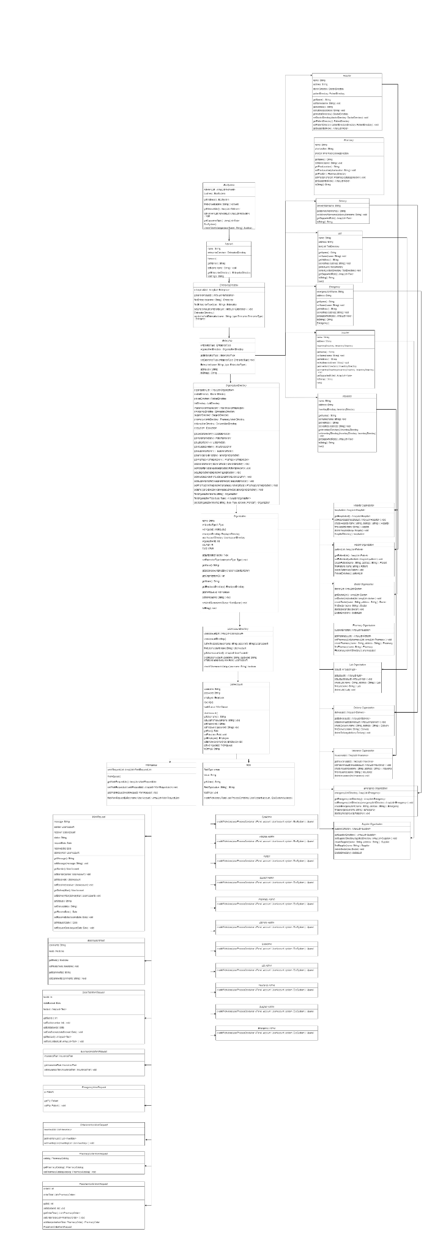
UML DIAGRAM

Slide 7
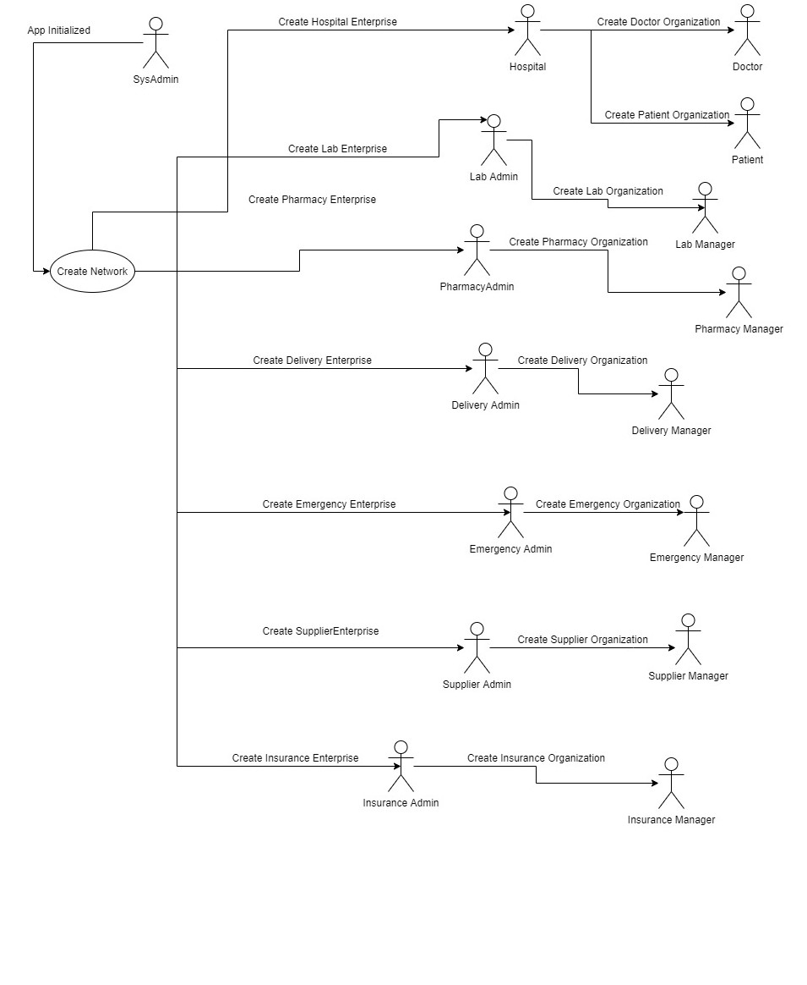
SEQUENCE DIAGRAM

Slide 8
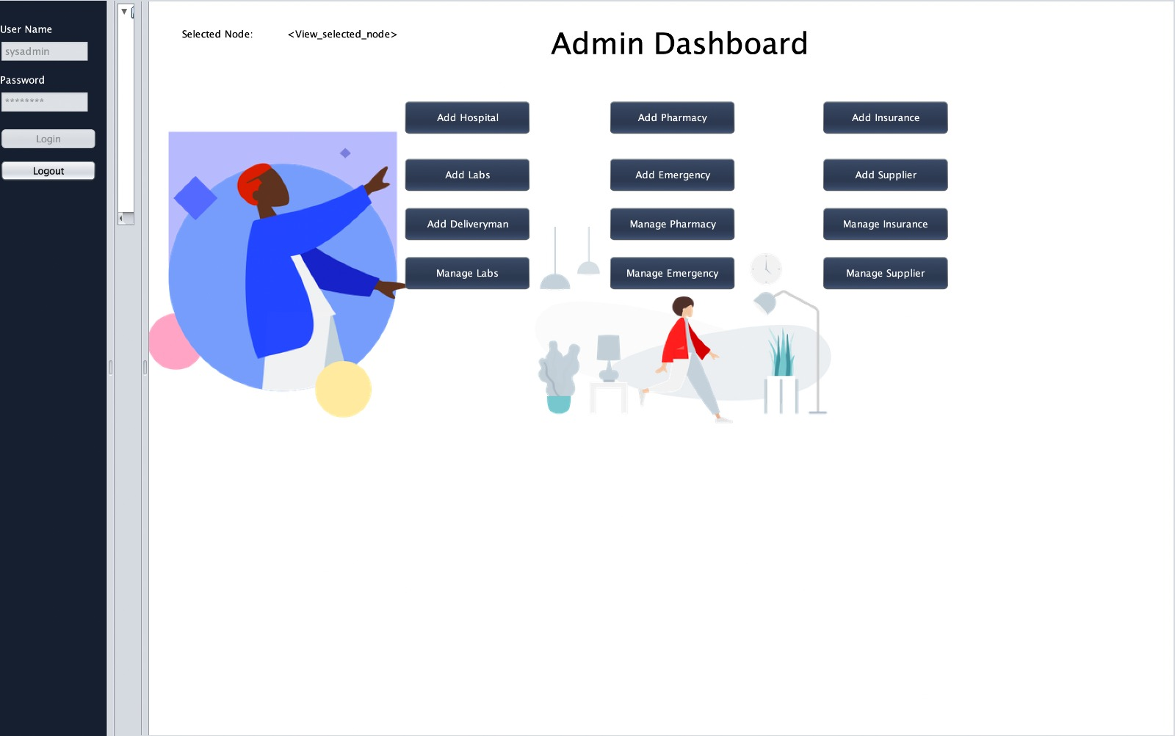
Admin Dashboard

Slide 9
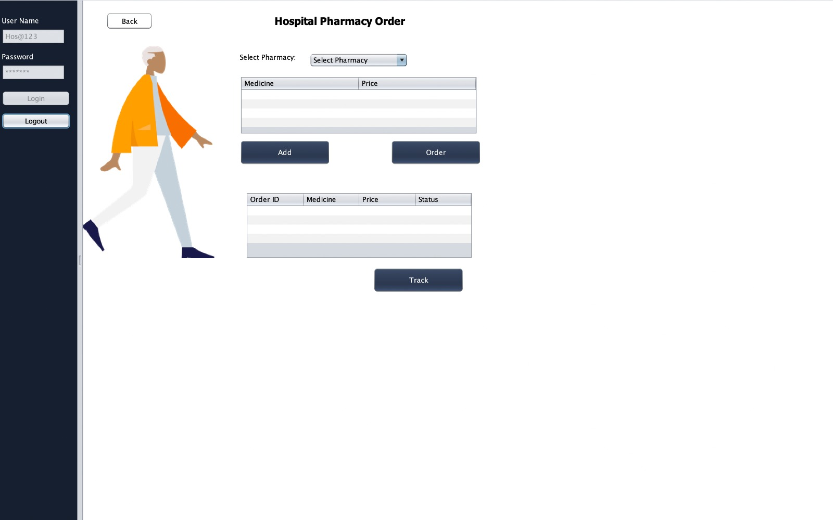
Order Medicine

Slide 10
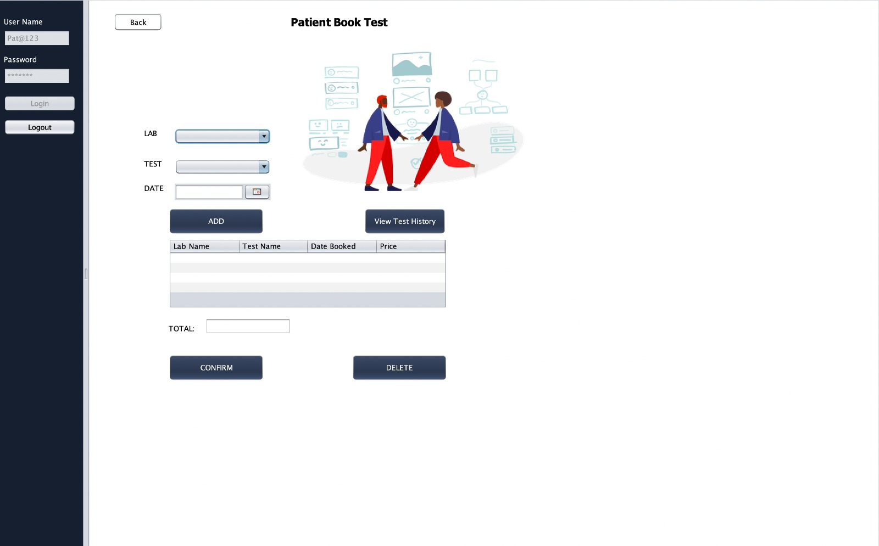
Book Appointment

Slide 11
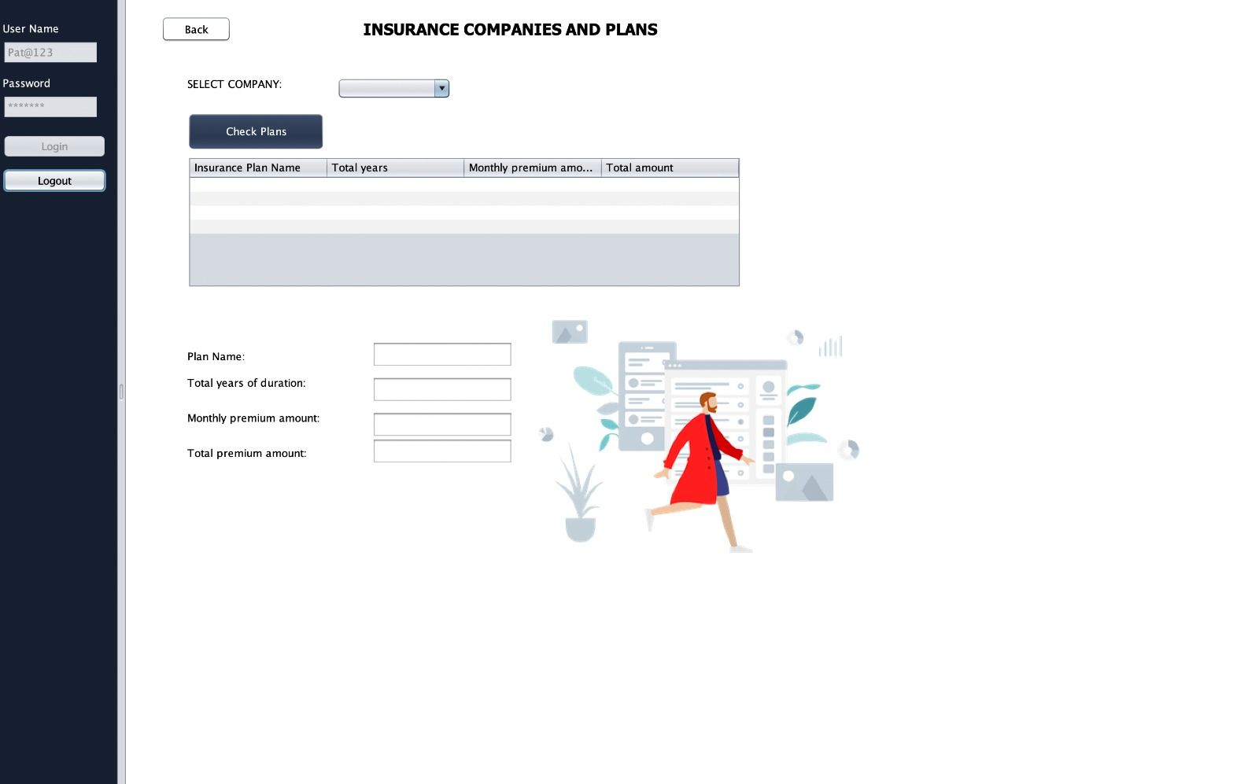
Insurance

Slide 12
FUTURE SCOPE
GLOBAL EXPANSION
CHAT BOT
BLOOD BANK
This system can be implemented globally by integrating many countries in the Network
Provide real-time 24/7 support for patient to simply chat with a dedicated support team about their queries.
Integrate a network of blood banks to hospitals for emergency situations.

Slide 13

THANK YOU

